Slide 1
Java String
Generally, String is a sequence of characters.
But in Java, string is an object that represents a sequence of characters.
The java.lang.String class is used to create a string object.
There are two ways to create String object
By new keyword
By without new keyword (String Literal)
■
■
1

Slide 2
String class constructors

Slide 3
Create a variable of type String and assign it a value:
public class StringExample{
public static void main(String args[]){
String s1="java"; //creating string by Java string literal
char ch[]={'s','t','r','i','n','g','s'};
String s2=new String(ch); //converting char array to string
String s3=new String("example");//creating Java string by new keyword
System.out.println(s1); System.out.println(s2);
System.out.println(s3);
}}
3

Slide 4

String Literal - String str = “Hello”
How it is working in the backend?
str
Hello
String objects are stored in a special memory area known as the "string constant pool".
String pool
Heap

Slide 5


String Literal - String str = “Hello”
How it is working in the backend? String str1 = “Hello”
If we create an object using String literal. It may return an existing object from the String pool, if it already exists.
Otherwise, it will create a new String object and put in the string pool for future re-use.
str
Hello
The same reference will be assigned to str and str1.
str1
Why Java uses the concept of String literal? To make Java more memory efficient (because no new objects are created if it exists already in the string constant pool).
String pool
Heap

Slide 6



new - String s = new String(“Hello”)
How it is working in the backend?
str
Hello
str1
s
String pool
Heap

Slide 7


new - String s = new String(“Hello”)
How it is working in the backend?
In such case, JVM will create a new string object in heap memory, and the literal “Hello" will be placed in the string constant pool. The variable “s” will refer to the object in a heap.
Therefore, if we compare performance of string literal and string object, string object will always take more time to execute than string literal because it will construct a new string every time it is executed.
Note: Execution time is compiler dependent.
str
Hello
str1
s
Hello
String pool
Heap

Slide 8
class StringStorage {
public static void main(String args[])
{
String s1 = "TAT"; String s2 = "TAT";
String s3 = new String("TAT");
String s4 = new String("TAT"); System.out.println(s1); System.out.println(s2); System.out.println(s3); System.out.println(s4);
}
}

Slide 9
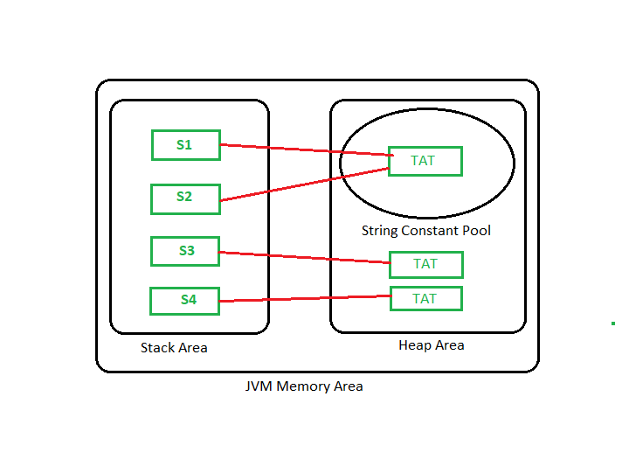

Slide 10
Java String split()
Splits the string at the specified string
(regex)
Java String compareTo()
Compares two strings in the dictionary order
Java String compareToIgnoreCase() Compares two strings ignoring case differences
Java String length()
Returns the length of the string Java String replace()
Replace all matching characters/text in the
string
Java String replaceAll()
Replace all substrings matching the regex pattern
Java String substring()
Returns a substring from the given string
Java String equals()
Compares two strings

Slide 11
Java String trim()
Removes any leading and trailing whitespace
Java String charAt()
Returns the character at the given index
Java String toLowerCase()
Converts characters in the string to lower case
Java String concat()
Concatenates two strings and returns it Java String valueOf()
Returns the string representation of a value Java String matches()
checks whether the string matches the given regex
Java String startsWith()
Checks if the string begins with the given
string
Java String valueOf()
Returns the string representation of a value

Slide 12
Java String matches()
checks whether the string matches the given regex
Java String startsWith()
Checks if the string begins with the given string
Java String equalsIgnoreCase() Compares two strings ignoring case differences
Java String contains()
Checks whether the string contains a substring
Java String indexOf() Returns the index of the character/substring Java String endsWith()
Checks if the string ends with the given string
Java String isEmpty()
Checks whether a string is empty or not

Slide 13
Java String intern()
Returns a canonical representation of the string
Java String getBytes()
Encodes the string into a sequences of bytes
Java String contentEquals()
Checks whether the string is equal to charSequence
Java String hashCode()
Returns a hash code for the string Java String join()
Joins the given strings using the delimiter Java String replaceFirst()
Replace the first matching substring
Java String subSequence()
Returns a subsequence from the string Java String toCharArray()
Converts the string to a char array Java String format()
Returns a formatted string

Slide 14
The charAt() method
The java String charAt() method returns a char value at the given index number
The index number starts from 0 and goes up to (n-1), where n is length of the string.

Slide 15
1
2
3
4
5
6
7
8
9
1
0
1
1
1
2
// Predict the output of the below code
class Main{
public static void main(String args[]){ String str = "Java";
char ch = str.charAt(2); System.out.println(ch); System.out.println(str.charAt(3)); System.out.println(str.charAt(4)); System.out.println(str.charAt(-1));
}
}
1
Output
3
1
4
1
5
v
a
Error

Slide 16
The toUpperCase() method
The java String toUpperCase() method converts all the lowercase characters of a string into uppercase
It will not alter the already existing uppercase characters in the string.
E.g: System.out.print(“You are on the right track”.toUpperCase());
Output: YOU ARE ON THE RIGHT TRACK

Slide 17
The toLowerCase() method
The java String toLowerCase() method converts all the uppercase characters of a string into lowercase
It will not alter the already existing lowercase characters in the string.
E.g: System.out.print(“YOU ARE ON THE RIGHT TRACK”.toLowerCase());
Output: you are on the right track

Slide 18
The concat() method
The Java string concat() method allows you to join two strings. This method returns a string with the value of the string passed into the method is appended to the end of the string.
E.g:
String s1 = "Nice "; String s2 = " Day";
System.out.println(s1.concat(s2));
Output: Nice Day

Slide 19
+ operator
+ operator is also used to concatenate strings
E.g:
System.out.println("You " + "are " + "the " + "best");
Output:
You are the best

Slide 20
1
2
3
4
5
6
7
8
9
1
0
1
1
1
2
1
3
1
4
class Main{
public static void main(String[] args) { String s = "Are", t = "you", u = "ready"; System.out.println(s + t + u); System.out.println(s.concat(t));
}
}
Output: Areyouready Areyou
Number of arguments the concat() method and + operator takes:
concat() method takes only one argument of string and concatenate it with other string.
+ operator takes any number of arguments and concatenates all the strings.
1
5
1

Slide 21
1
2
3
4
5
6
7
8
9
1
0
1
1
1
2
1
3
1
4
class Main{
public static void main(String args[]){ String s = 50 + 50 + "error" + 50 + 50; System.out.println(s);
}
}
1
5
1

Slide 22
Strings
when you create a String object, you are creating a string that cannot be changed.
That is, once a String object has been created, you cannot change the characters that comprise that string.
To create modifiable string Java provides two options:
    StringBuffer
    StringBuilder
  The String, StringBuffer, and StringBuilder classes are defined in java.lang.
  Thus, they are available to all programs automatically.
  All are declared final, which means that none of these classes may be subclassed

Slide 23
StringBuffer
StringBuffer represents growable and writeable character sequences.
StringBuffer may have characters and substrings inserted in the middle or appended to the end.
StringBuffer will automatically grow to make room for such additions and often has more characters preallocated than are actually needed, to allow room for growth.
Java uses both classes heavily, but many programmers deal only with String

Slide 24
StringBuffer class
Mutable String: A String that can be modified or changed is known as mutable String. StringBuffer and StringBuilder classes are used for creating mutable strings.
Constructor | Description
StringBuffer() | It creates an empty String buffer with the initial capacity of 16.
StringBuffer(String str) | It creates a String buffer with the specified string..
StringBuffer(int capacity) | It creates an empty String buffer with the specified capacity as length.
24

Slide 25
String Buffer Class methods
public synchronized StringBuffer | append(String s) | It is used to append the specified string with this string.
public synchronized StringBuffer | insert(int offset, String s) | It is used to insert the specified string with this string at the specified position.
public synchronized StringBuffer | replace(int startIndex, int endIndex, String str) | It is used to replace the string from specified startIndex and endIndex.
public synchronized StringBuffer | delete(int startIndex, int endIndex) | It is used to delete the string from specified startIndex and endIndex.
public synchronized StringBuffer | reverse() | is used to reverse the string.

Slide 26
public int | capacity() | It is used to return the current capacity.
public void | ensureCapacity(int minimumCapacity) | It is used to ensure the capacity at least equal to the given minimum.
public char | charAt(int index) | It is used to return the character at the specified position.
public int | length() | It is used to return the length of the string i.e. total number of characters.
public String | substring(int beginIndex) | It is used to return the substring from the specified beginIndex.
public String | substring(int beginIndex, int endIndex) | It is used to return the substring from the specified beginIndex and endIndex.

Slide 27
StringBufferExample.java
class StringBufferExample
{
public static void main(String args[])
{
  StringBuffer sb=new StringBuffer("Hello ");
  sb.append("Java");//now original string is changed System.out.println(sb);//prints Hello Java
  StringBuffer sb1=new StringBuffer("Hello");
  sb1.delete(1,3);
  System.out.println(sb1);//prints Hlo
  StringBuffer sb2=new StringBuffer("Hello");
  sb2.reverse();
  System.out.println(sb2);//prints olleH
}
}
27

Slide 28
class A
{
public static void main(String args[])
{
StringBuffer sb = new StringBuffer();
System.out.println(sb.capacity()); // default 16
sb.append("Hello");
System.out.println(sb.capacity()); // now 16
sb.append("java is my favourite language");
System.out.println(sb.capacity()); // now 34
// Now (16*2)+2=34 i.e (oldcapacity*2)+2
}
}
28

Slide 29
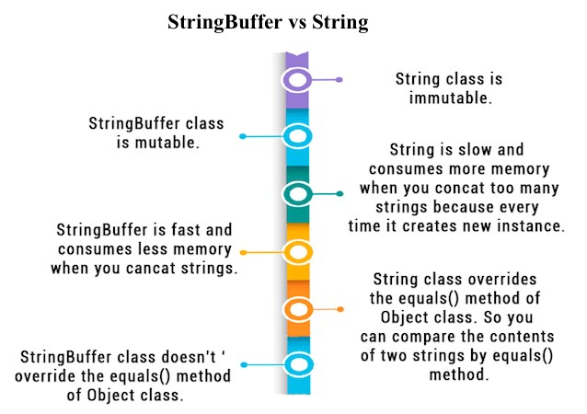
29

Slide 30
StringTokenizer class
StringTokenizer class in Java is used to break a string into tokens.
The StringTokenizer is available in java.util package
To use String Tokenizer class we have to specify an input string and a string that contains delimiters.
Delimiters are the characters that separate tokens.
Each character in the delimiter string is considered a valid delimiter.
Default delimiters are whitespaces, new line, space, and tab.
30

Slide 31
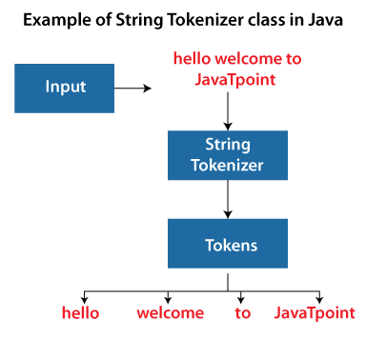

Slide 32
Constructors
Constructor | Description
StringTokenizer(String str) | It creates StringTokenizer with specified string.
StringTokenizer(String str, String delim) | It creates StringTokenizer with specified string and delimiter.
StringTokenizer(String str, String delim, boolean returnValue) | It creates StringTokenizer with specified string, delimiter and returnValue. If return value is true, delimiter characters are considered to be tokens. If it is false, delimiter characters serve to separate tokens.

Slide 33
Methods | Description
boolean hasMoreTokens() | It checks if there is more tokens available.
String nextToken() | It returns the next token from the StringTokenizer object.
String nextToken(String delim) | It returns the next token based on the delimiter.
boolean hasMoreElements() | It is the same as hasMoreTokens() method.
Object nextElement() | It is the same as nextToken() but its return type is Object.
int countTokens() | It returns the total number of tokens.

Slide 34
import java.util.StringTokenizer;
public class Simple
{
public static void main(String args[])
{
StringTokenizer st = new StringTokenizer(“welcome to second csbs"," ");
System.out.println("Total number of Tokens: "+ st.countTokens());
while (st.hasMoreTokens())
{
System.out.println(st.nextToken());
}
}
}
Output
Total number of Tokens: 4
Welcome
To
Second
csbs

Slide 35
Introduction and working with lambda variables in java
In Java, a lambda expression is a block of code that accepts arguments and returns a value.
The lambda expression was originally introduced in Java 8(JDK8), and it improves Java’s expressive capabilities.
Lambda expressions are similar to methods, but they do not need a name and they can be implemented right in the body of a method.
The Lambda expression is used to provide the implementation of a functional interface.
An interface which has only one abstract method is called functional interface.
Why use Lambda Expression
  To provide the implementation of Functional interface.
  Less coding.

Slide 36
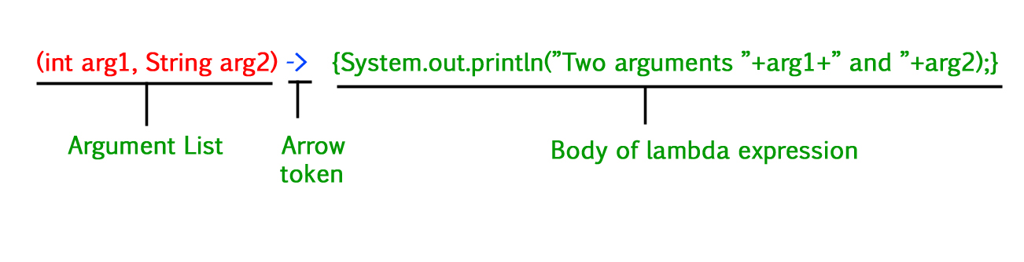
Syntax
1. The simplest lambda expression contains a single parameter and an expression:
parameter -> expression
2. To use more than one parameter, wrap them in parentheses:
(parameter1, parameter2) -> expression
Note:
Expressions are limited.
They have to immediately return a value, and they cannot contain variables, assignments or statements such as if or for.
In order to do more complex operations, a code block can be used with curly braces.
If the lambda expression needs to return a value, then the code block should have a return statement.
Ex:
(parameter1, parameter2) -> { code block }

Slide 37
// A sample functional interface
interface FuncInterface
{
void abstractFun(int x); // An abstract function
default void normalFun() // A non-abstract (or default) function
  {
  System.out.println("Hello");
  }
}
class Test
{
public static void main(String args[])
{
/* lambda expression to implement above functional interface. This interface
by default implements abstractFun() */
FuncInterface fobj = (int x) -> System.out.println(2*x);
// This calls above lambda expression and prints 10.
fobj.abstractFun(5);
} output
} 10

